Slide 1
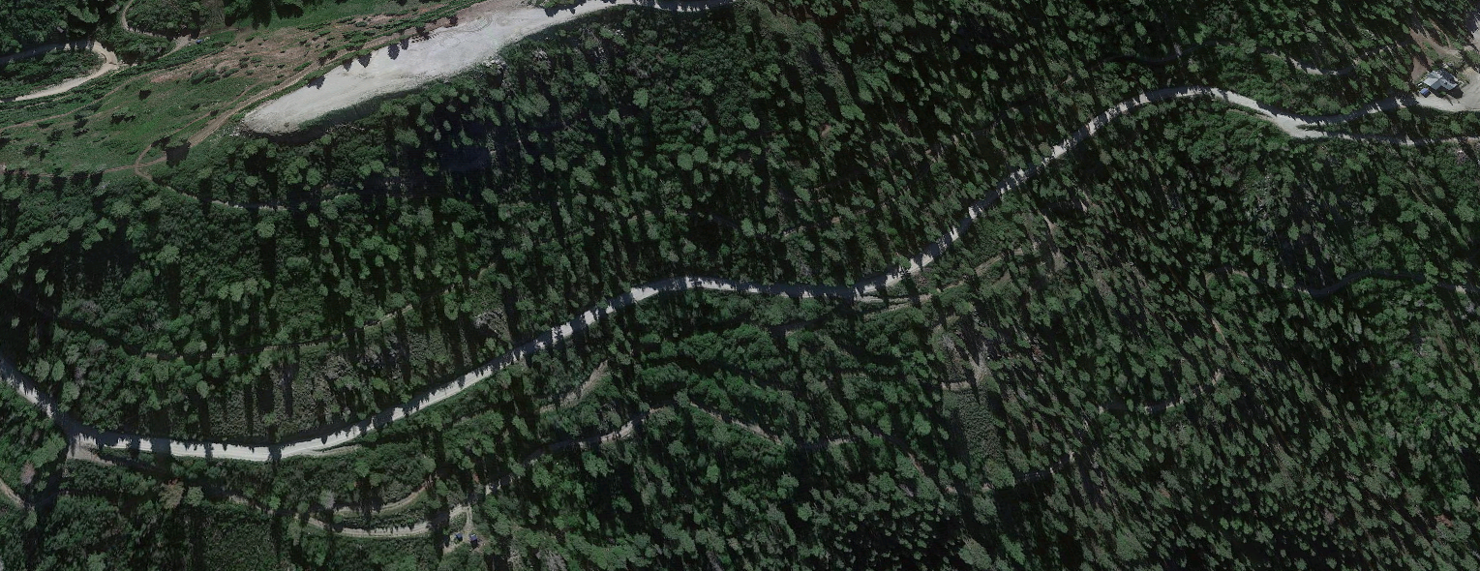
NNO - NOVICE: 1 LAP
Race Distance 1 Kilometer
BITTER ROOT LIFT
BUTTERCUP LOT
FRONTIER
POINT
NORDIC
LODGE
NORDIC HWY
BUTTERCUP LOT
WAY OF TRAVEL:
CLOCK WISE
NOV
REDTAIL TRAIL
EXIT A
START TIME:

Slide 2
NIN - INTERMEDIATE: 2 LAPS
Race Distance 3 Kilometers
BITTER ROOT LIFT
BUTTERCUP LOT
FRONTIER
POINT
NORDIC
LODGE
NORDIC HWY
BUTTERCUP LOT
WAY OF TRAVEL:
CLOCK WISE
#2
REDTAIL TRAIL
EXIT A
2ND LAP
NORDIC HWY
#1
START TIME:
EXIT B
1ST LAP
LAP 1
LAP 2 CUTOFF

Slide 3
NEX - EXPERT: 2 LAPS
Race Distance 5 Kilometers
BITTER ROOT LIFT
BUTTERCUP LOT
FRONTIER
POINT
NORDIC
LODGE
NORDIC HWY
BUTTERCUP LOT
WAY OF TRAVEL:
CLOCK WISE
NOV
REDTAIL TRAIL
EXIT A
#1
#2
EXIT B
NORDIC HWY
START TIME:
LAP 1
LAP 2 CUTOFF
THE FLUSH

